Slide 1
International Debt Statistics Analysis
By
Harsh Sharma

Slide 2
Contents
Introduction​
Project tasks​
Data Visualization Procedure
​Final Result
Conclusion

Slide 3
Introduction
It's not that we humans only take debts to manage our necessities. A country may also take debt to manage its economy. For example, infrastructure spending is one costly ingredient required for a country's citizens to lead comfortable lives. The World Bank is the organization that provides debt to countries.
In this project, you are going to analyze international debt data collected by The World Bank. The dataset contains information about the amount of debt (in USD) owed by developing countries across several categories. You are going to find the answers to questions like:
1. What is the total amount of debt that is owed by the countries listed in the
dataset?
2.Which country owns the maximum amount of debt and what does that amount
look like?
3. What is the average amount of debt owed by countries across different debt
indicators?
The data used in this project is provided by The World Bank. It contains both national and regional debt statistics for several countries across the globe as recorded.

Slide 4
Project tasks
1. The World Bank's international debt data
2. Finding the number of distinct countries
3. Finding out the distinct debt indicators
4. the amount of debt owed by the countries
5. Country with the highest debt.
6. Average amount of debt across indicators
7. The highest amount of principal repayments
8. The most common debt indicator
9. Other viable debt issues and conclusion

Slide 5
Data Visualization Procedure
Downloaded the data from The World bank’s Official Site. (https://datacatalog.worldbank.org/dataset/international-debt-statistics)
Imported it into Power BI report.
Created Measures and Renamed Column Names.
Created Visualisations from Data and Measures.
Drew out final conclusions.
Published and Saved the report in BI Service and Desktop.

Slide 6
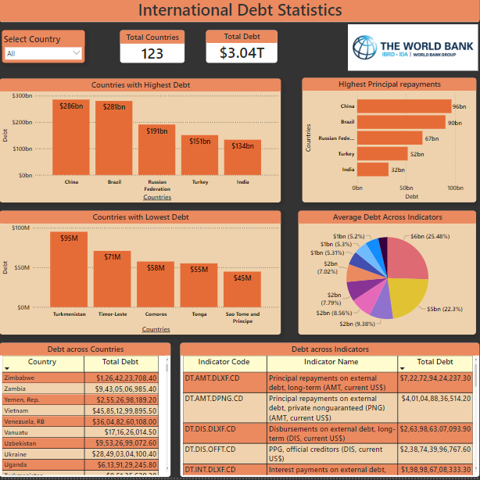
Final Result
Created Visuals using tables, Cards, Columns etc.
Filtered out some of the rows containing Regions and UN Classifications.
Formatted the tables and visuals in clear and presentable format to publish in Power Bi service.

Slide 7
COnclusion
In this project, we took a look at debt owed by countries across the globe. We extracted a few summary statistics from the data and unravelled some interesting facts and figures. We also validated our findings to make sure the investigations are correct. Here are some key insights from the Project -
The world bank is owed over USD $3 trillions.
China leads the Table with a massive debt of USD $ 285Bn across all debt indicators , followed by brazil with a debt of USD $281bn across all debt indicators.
China also leads the table with highest amount of Principal payments amounting to USD $96 bn.
There is a total of six debt indicators in which all the countries listed in the Report have taken Debts.
They also include both Long term and Short term loans as well as both government and private creditors.

Slide 8
THANK YOU
Harsh Sharma, BBA
Harshwork99@gmail.com
Github.com/HarshWork99

